Slide 1
Detailed Design
Zeeshan Ali Rana

Slide 2
Design Methodology (Recap)
Design decisions are periodically revisited and revised
Refactoring
to simplify complicated solutions or to optimize the design

Slide 3
Design Principles
Design principles are guidelines for decomposing a system’s required functionality and behavior into modules
The principles identify the criteria
for decomposing a system
deciding what information to provide (and what to conceal) in the resulting modules
Six dominant principles (general):
Interfaces
Information hiding
Incremental development
Abstraction
Generality
Modularity

Slide 4
Interfaces
An interface defines what services the software unit provides to the rest of the system, and how other units can access those services
For example, the interface to an object is the collection of the object’s public operations and the operations’ signatures, which specify each operation’s name, parameters, and possible return values
An interface must also define what the unit requires, in terms of services or assumptions, for it to work correctly
A software unit’s interface describes what the unit requires of its environment, as well as what it provides to its environment

Slide 5
Interfaces (Contd.)
A software unit may have several interfaces that make different demands on its environment or that offer different levels of service
Module
Data
________________
_________________
_________________
Operation 1
_________________
_________________
_________________
_________________
Operation 2
_________________
_________________
_________________
_________________
Interface A
Operation 1 ()
Operation 2 ()
Operation 4 ()
Operation 3
_________________
_________________
_________________
_________________
Operation 4
_________________
_________________
_________________
_________________
Interface B
Operation 2 ()
Operation 3 ()

Slide 6
Interfaces (Contd.)
The specification of a software unit’s interface describes the externally visible properties of the software unit
An interface specification should communicate to other system developers everything that they need to know to use our software unit correctly
Purpose
Preconditions (assumptions)
Protocols
Postconditions (visible effects)
Quality attributes

Slide 7
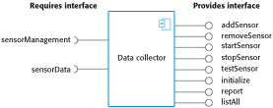
A Component with Interfaces

Slide 8
Information Hiding
Information hiding is distinguished by its guidance for decomposing a system:
Each software unit encapsulates a separate design decision that could be changed in the future
Then the interfaces and interface specifications are used to describe each software unit in terms of its externally visible properties (to help its reuse)
Using this principle, modules may exhibit different kinds of cohesion
A module that hides a data representation may be informationally cohesive
A module that hides an algorithm may be functionally cohesive
Advantages of information hiding is that the resulting software units are loosely coupled, and programmer know only what they need to know

Slide 9
Modularity
Modularity is the principle of keeping the unrelated aspects of a system separate from each other,
each aspect can be studied in isolation (also called separation of concerns)
If the principle is applied well, each resulting module will have a single purpose and will be relatively independent of the others
each module will be easy to understand and develop
easier to locate faults
because there are fewer suspect modules per fault
Easier to change the system
because a change to one module affects relatively few other modules
To determine how well a design separates concerns, we use two concepts that measure module independence: coupling and cohesion

Slide 10
Modularity: Coupling
Two modules are tightly coupled when they depend a great deal on each other
Loosely coupled modules have some dependence, but their interconnections are weak
Uncoupled modules have no interconnections at all; they are completely unrelated
Uncoupled -
no dependencies
Loosely coupled -
some dependencies
Tightly coupled -
many dependencies

Slide 11
Modularity: Coupling
There are many ways that modules can depend on each other:
The references made from one module to another
The amount of data passed from one module to another
The amount of control that one module has over the other
Coupling can be measured along a spectrum of dependence

Slide 12
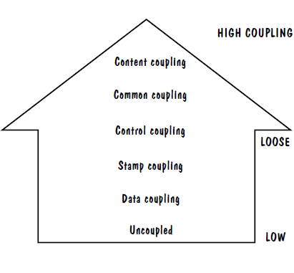
Modularity: Coupling: Types of Coupling
Content coupling
Common coupling
Control coupling
Stamp coupling
Data coupling
High coupling is not desired

Slide 13
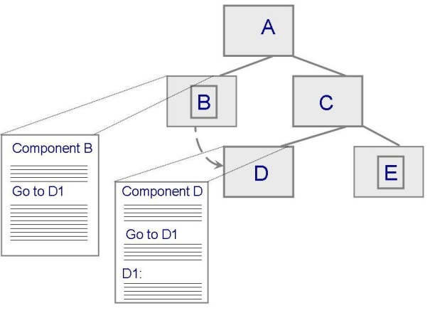
Modularity: Coupling: Content Coupling
One component modifies an internal data item of another component, a component (e.g. B) branches into another component (e.g. D)
Module B
_________________
_________________
_________________
_________________
Goto D1
_________________
_________________
_________________
_________________
_________________
_________________
_________________
_________________
Module D
_________________
_________________
_________________
_________________
_________________
_________________
D1:
_______________
_________________
_________________
_________________

Slide 14
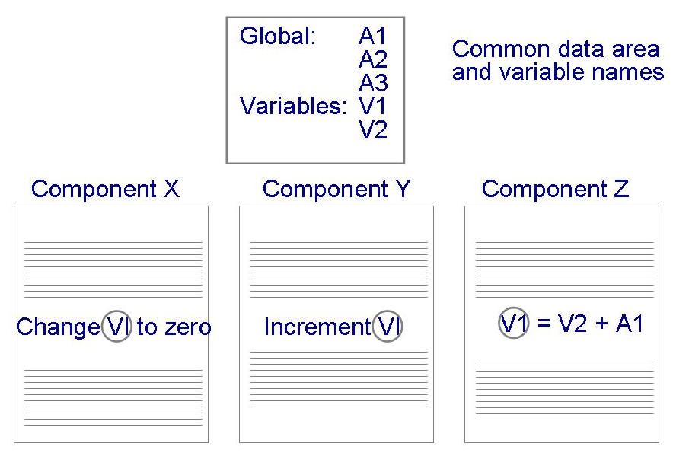
Modularity: Coupling: Common Coupling
Dependency due to common data. Which component is responsible to set a particular value for the common variable?
Tracing back to all components that access those data to evaluate the effect of the change

Slide 15
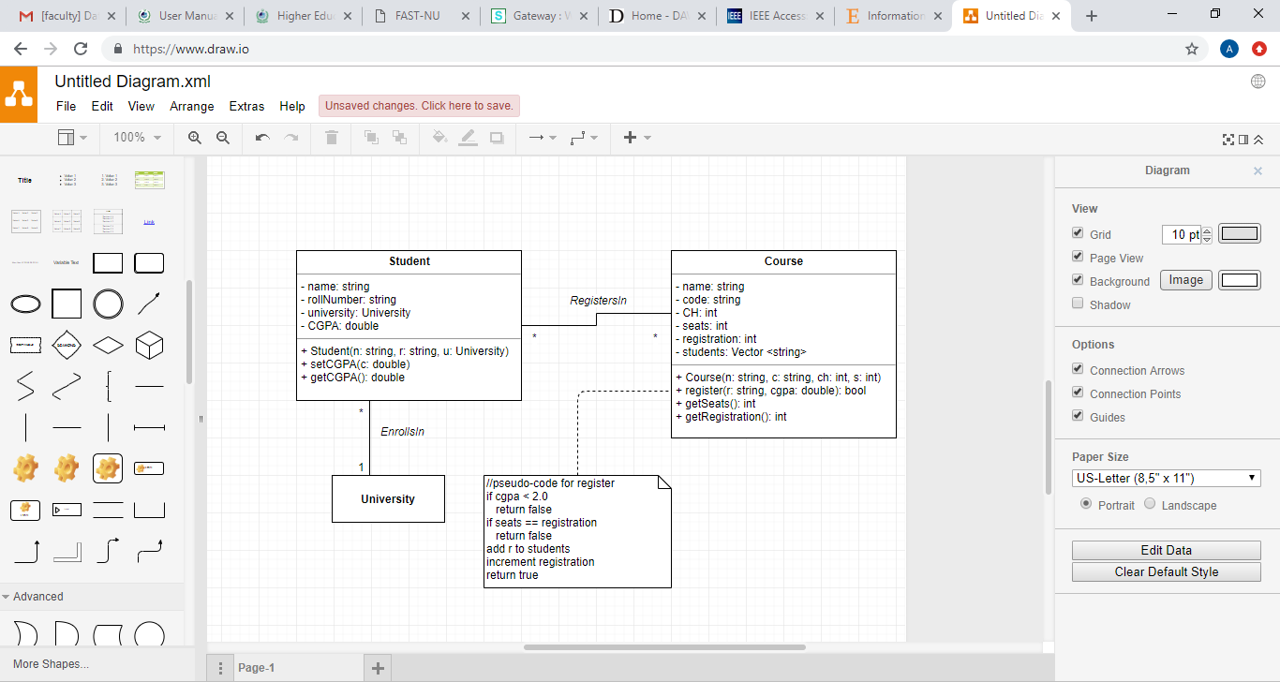
Modularity: Coupling: Control Coupling
One component passes parameters to control the activity of another component
The controlled component cannot function without direction from the controlling component
Make each component perform only one function

Slide 16
Modularity: Coupling: Stamp and Data Coupling
Stamp coupling occurs when complex data structures are passed between modules
Stamp coupling represents a more complex interface between modules, because the modules have to agree on the data’s format and organization
If only data values, and not structured data, are passed, then the modules are connected by data coupling
Data coupling is simpler and less likely to be affected by changes in data representation
Only data value is passed from one component to another
Easiest to trace data and make changes
See Pressman for Type Use coupling

Slide 17
Modularity: Coupling: Types of Coupling
Content coupling
Common coupling
Control coupling
Stamp coupling
Data coupling
High coupling is NOT desired

Slide 18
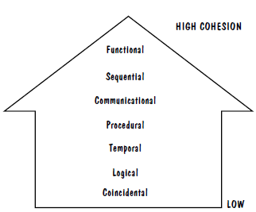
Modularity: Cohesion: Types of Cohesion
Cohesion refers to the dependence within and among a module’s internal elements (e.g., data, functions, internal modules)
Informational
Low cohesion is not desired

Slide 19
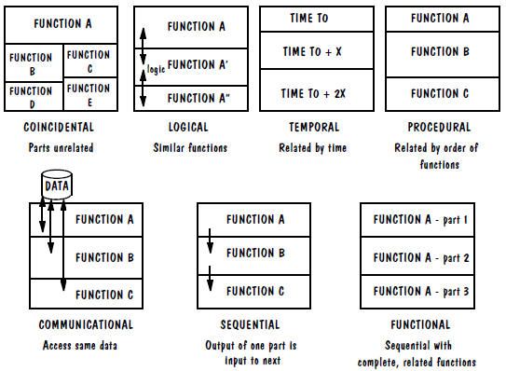
Modularity: Cohesion: Types of Cohesion

Slide 20
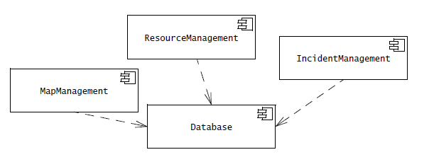
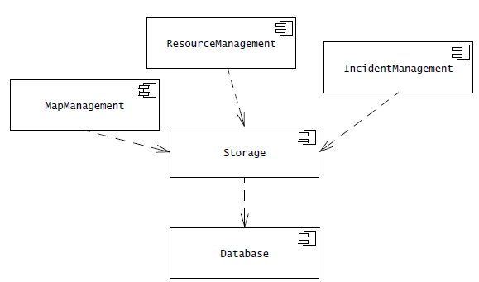
Coupling?

Slide 21
Incremental Development
Given a design consisting of software units and their interfaces, we can use the information about the units’ dependencies to devise an incremental schedule of development
Start by mapping out the units’ uses relation
relates each software unit to the other software units on which it depends
Uses graphs can help to identify progressively larger subsets of our system that we can implement and test incrementally

Slide 22
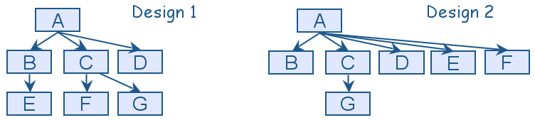
Incremental Development
Uses graphs for two designs
Fan-in refers to the number of units that use a particular software unit
Fan-out refers to the number of units used by particular software unit

Slide 23
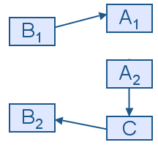
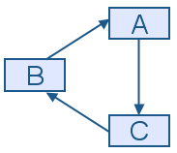
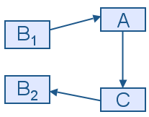
Incremental Development
We can try to break a cycle in the uses graph using a technique called sandwiching
One of the cycle’s units is decomposed into two units, such that one of the new units has no dependencies
Sandwiching can be applied more than once, to break either mutual dependencies in tightly coupled units or long dependency chains
(a)
(b)
(c)

Slide 24
Abstraction
An abstraction is a model or representation that omits some details so that it can focus on other details
The definition is vague about which details are left out of a model, because different abstractions, built for different purposes, omit different kinds of details in order to focus on one part/aspect and avoid distractions
Types: Decomposition, Interface Specification, Views, VM

Slide 25
Side bar: Using Abstraction
Suppose that one of the system functions is to sort the elements of a list L. The initial description of the design is:
Sort L in non-decreasing order
The next level of abstraction may be a particular algorithm:
DO WHILE I is between 1 and (length of L)–1:
Set LOW to index of smallest value in L(I),..., L(length of L)
Interchange L(I) and L(LOW)
ENDDO
The algorithm provides a great deal of additional information, however, it can be made even more detailed

Slide 26
Side bar: Using Abstraction
The third and final algorithm describes exactly how the sorting operation will work:
DO WHILE I is between 1 and (length of L)-1
Set LOW to current value of I
DO WHILE J is between I+1 and (length of L)
IF L(LOW) is greater than L(J)
THEN set LOW to current value of J
ENDIF
ENDDO
Set TEMP to L(LOW)
Set L(LOW) to L(I)
Set L(I) to TEMP
ENDDO
Use the level of abstraction after determining which details are not required

Slide 27
Generality
Generality is the design principle that makes a software unit as universally applicable as possible, to increase the chance that it will be useful in some future system (reusability)
Amortize the cost of module development
We make a unit more general by increasing the number of contexts in which it can be used. There are several ways of doing this:
Parameterizing context-specific information
Removing preconditions
Simplifying postconditions

Slide 28
Generality (Contd.)
The following four procedure interfaces are listed in order of increasing generality:
PROCEDURE SUM: INTEGER;
POSTCONDITION: returns sum of 3 global variables
PROCEDURE SUM (a, b, c: INTEGER): INTEGER;
POSTCONDITION: returns sum of parameters
PROCEDURE SUM (a[]: INTEGER; len: INTEGER): INTEGER
PRECONDITION: 0 <= len <= size of array a
POSTCONDITION: returns sum of elements 1..len in array a
PROCEDURE SUM (a[]: INTEGER): INTEGER
POSTCONDITION: returns sum of elements in array a

Slide 29
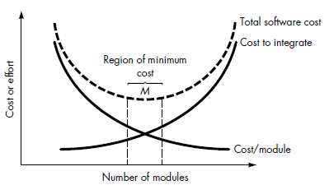
Applying Design Principles
Modularity?
over/under modularize?

Slide 30
Applying Design Principles
Modularity?
Coupling and Information Hiding?
Generality and customization
Information Hiding, Interfaces, Abstraction, Modularity

Slide 31
Representing Design(Exercise) Sidebar 6.4 Royal Service Station Requirements of PFleeger
Royal Service station provides three types of services
The system must track bills, the product and services
System to control inventory
The system to track credit history, and payments overdue
The system applies only to regular repeat customer
The system must handle the data requirements for interfacing with other system
The system must record tax and related information
The station must be able to review tax record upon demand
The system will send periodic message to customers
Customer can rent parking space in the station parking lot
The system maintain a repository of account information
The station manager must be able to review accounting information upon demand
The system can report an analysis of prices and discounts
The system will automatically notify the owners of dormant accounts
The system can not be unavailable for more than 24 hours
The system must protect customer information from unauthorized access

Slide 32
References
Pfleeger Book slides from UCF
Book and slides by Pressman
Acknowledgement!
Some slides have been adapted from UCF slides for the SE course

